Slide 1
Image Filtering
POSCO AI Course: Computer Vision
Janghun Jo
Computer Graphics Lab.
jhjo432@postech.ac.kr

Slide 2
Contents
OpenCV
Basic Image IO
Show image
Image Filtering using OpenCV
Image filters
Box Filter
Sharpening Filter
Other Filters
Gaussian Filter
Edge detection
Image Gradient

Slide 3

OpenCV
OpenCV (Open Source Computer Vision Library: http://opencv.org) is an open-source library that includes several hundreds of computer vision algorithms.
C++, Python API
OpenCV Python API makes use of Numpy.

Slide 4
Basic IO
Read image
retval=cv.imread(filename[, flags])
Returns Numpy ndarray
Note: RGB images are loaded in BGR format!!!
Need to swap B and R channels if you want to use the image with other libraries.
Write image
retval=cv.imwrite(filename, img[, params])
For color image, expects BGR format image.
See official OpenCV documentation (https://docs.opencv.org/4.4.0/index.html) for more information.

Slide 5
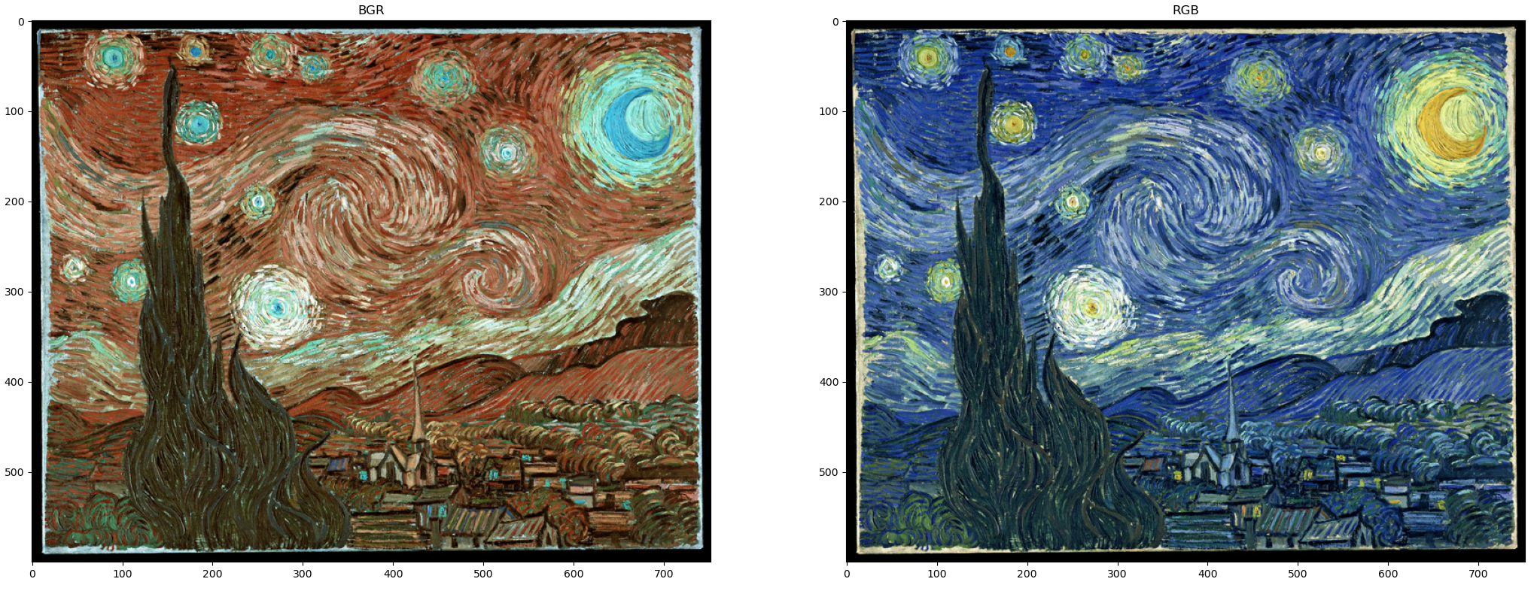
Basic IO
BGR vs RGB

Slide 6
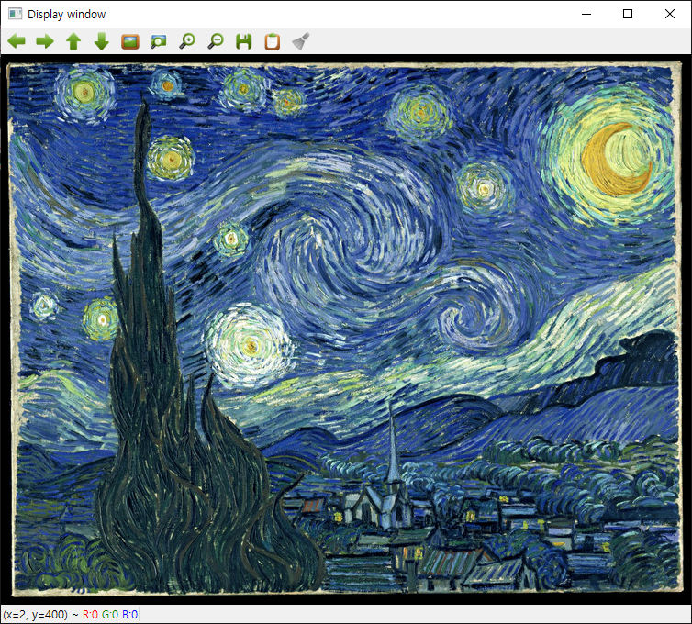
Show Image using OpenCV
Show image
None=cv.imshow(winname, mat)
Displays image in a window.
No need for convert images to RGB format
Able to specify GUI behavior (not covered)
Note: some issues with Jupyter

Slide 7
Linear filters
Step 1. Select only needed pixels
Pixel z
2
4
1
2
6
2
…
9
2
3
4
4
4
3
4
4
7
2
9
7
6
7
…
9
7
6
…
5
2
3
6
1
5
3
6
1
7
4
2
5
1
2
…
2
5
2
3
2
8
Notes:
To compute the average, the first step is to select the pixels in the 3x3 neighborhood.

Slide 8
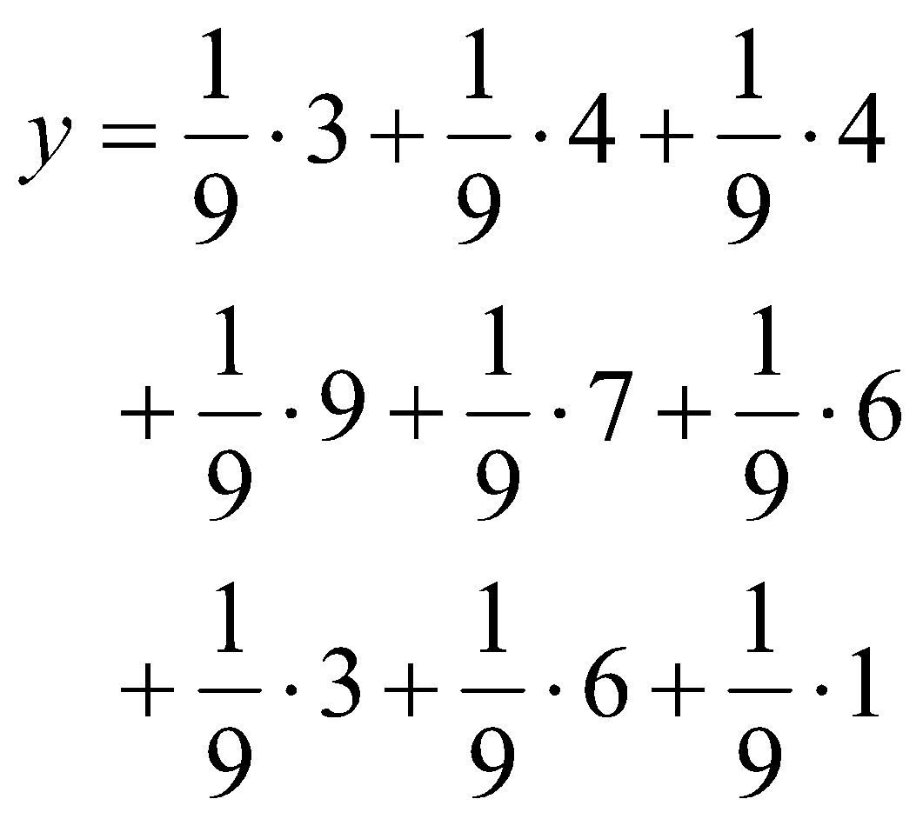

Linear filters
Step 2. Multiply every pixel by kernel and then sum up the values
…
3
4
4
…
9
7
6
…
3
6
1
…
X
1
1
1
1
1
1
1
1
1
Notes:
Then, we multiply every pixel by 1/9 and then sum up the values.
Then, we are done. We got the average of the 3x3 region centered at z.
Also note that the average is a linear combination of neighboring pixels of the pixel z.

Slide 9
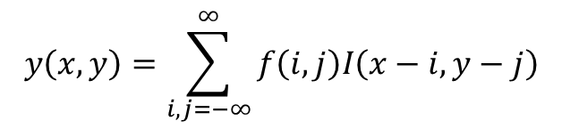
Linear filters
Example : 3x3 averaging kernel
Step 1: Move the window to the first location where we want to
compute the average value and then select only pixels
inside the window.
1
1
1
1
1
1
2
4
1
2
6
2
2
4
1
Step 2: Compute
the filtered value
1
1
1
9
2
3
4
4
4
9
2
3
7
2
9
7
6
7
7
2
9
5
2
3
6
1
5
Sub image p
7
4
2
5
1
2
Step 3: Place the
result at the pixel
in the output image
Original image
Step 4: Move the
window to the next
location and go to Step 2
4.3
Output image

Slide 10
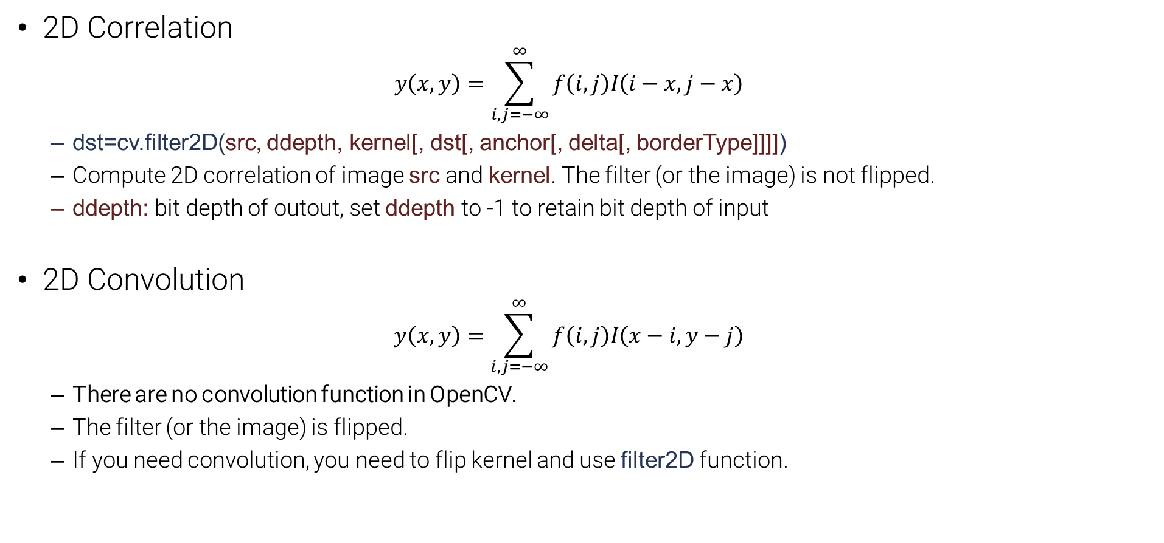
Image Filtering using OpenCV

Slide 11
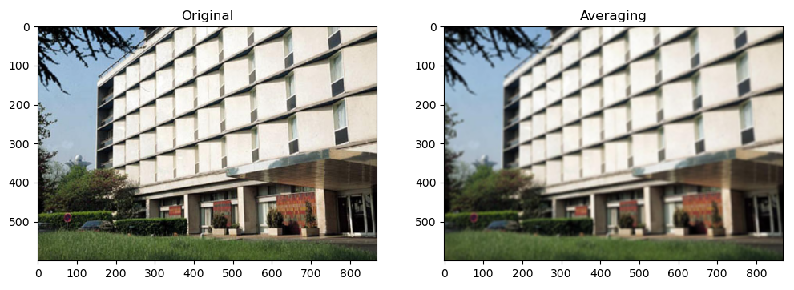
Box filter
Box filter (Average filter)
Averages pixels in a box shaped window.
Sum of kernel should be 1
1 | 1 | 1
1 | 1 | 1
1 | 1 | 1
kernel
1
9

Slide 12
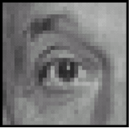
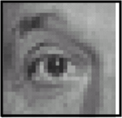
Other filters
input
filter
output
0 | 0 | 0
0 | 1 | 0
0 | 0 | 0
?
unchanged
input
filter
output
0 | 0 | 0
0 | 0 | 1
0 | 0 | 0
shift to left by one

Slide 13
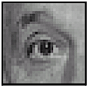
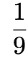
Sharpening filters
input
filter
output
0 | 0 | 0
0 | 2 | 0
0 | 0 | 0
1 | 1 | 1
1 | 1 | 1
1 | 1 | 1
?
-
sharpening
do nothing for flat areas
stress intensity peaks

Slide 14
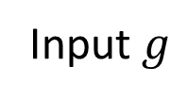
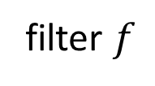
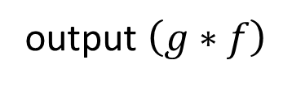
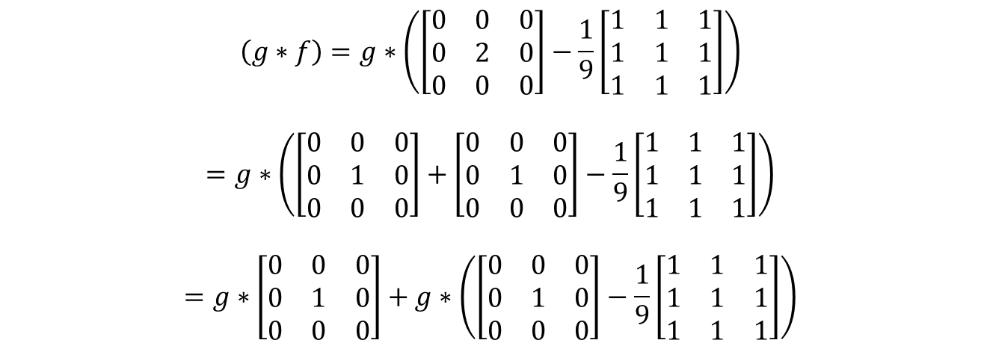
Sharpening filters
0 | 0 | 0
0 | 2 | 0
0 | 0 | 0
1 | 1 | 1
1 | 1 | 1
1 | 1 | 1
?
* (
-
) =
High-pass filter
To obtain high-frequency details
* A high-pass filter can be obtained by subtracting a low-pass filter from a delta function.

Slide 15
Quiz 1. Sharpening filters
Quiz: Sharpening 필터 구현
박스 필터를 이용하여 sharpening 필터를 구현
박스 필터의 크기는 7으로 구현.
커널의 합이 1이여야 함
구현 결과 이미지를 미리 저장된 이미지와 비교하여 테스트
input
filter
output
0 | 0 | 0
0 | 2 | 0
0 | 0 | 0
1 | 1 | 1
1 | 1 | 1
1 | 1 | 1
?
-
sharpening

Slide 16
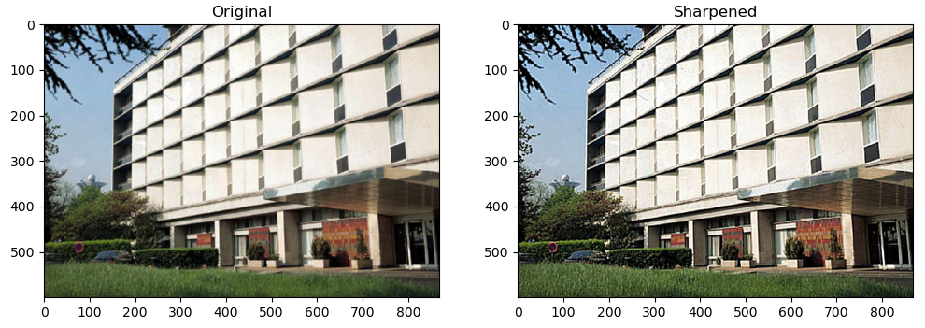
Sharpening examples

Slide 17
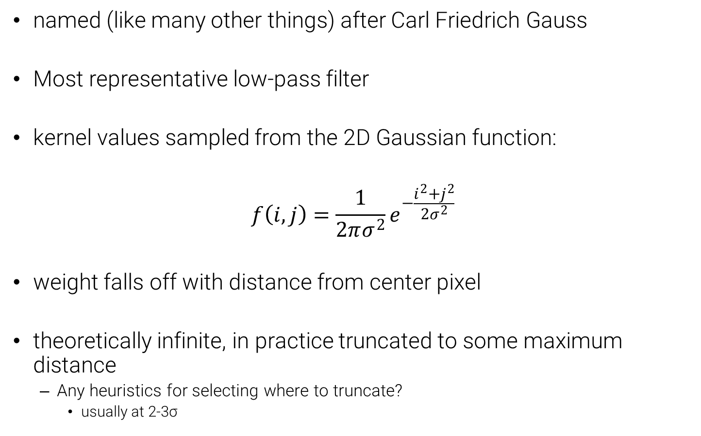
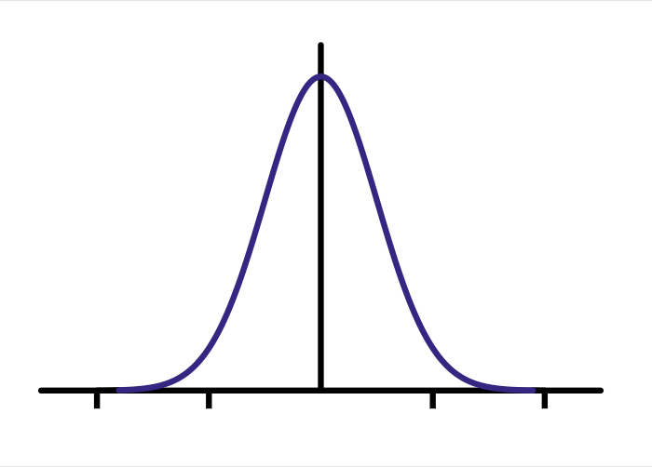
The Gaussian filter
1 | 2 | 1
2 | 4 | 2
1 | 2 | 1
kernel
1
16

Slide 18
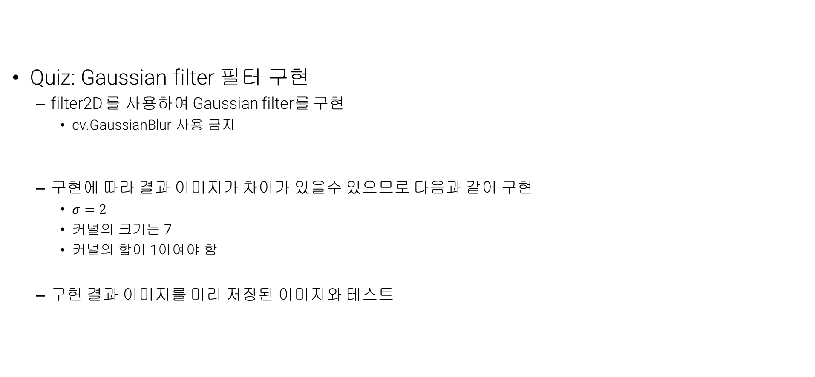
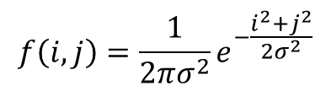
Quiz 2. Gaussian filter

Slide 19
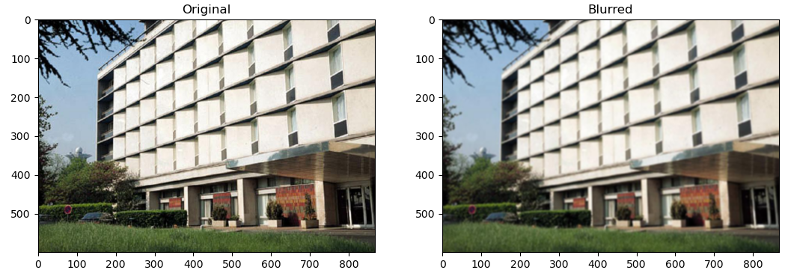
Gaussian filtering example

Slide 20
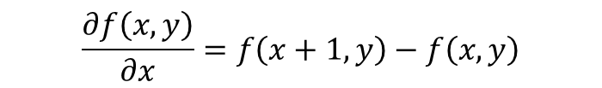
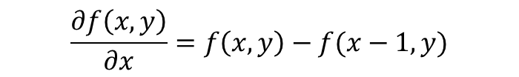
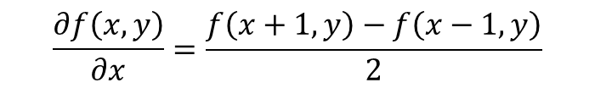
Gradients
Computing finite differences can be implemented using convolution operations
1 | -1 | 0
Note that the kernel is flipped because of the definition of convolution!
Forward finite difference
0 | -1 | 1
Backward finite difference
0.5 | 0 | -0.5
Central finite difference

Slide 21
The Sobel filter
A combination of central finite difference and Gaussian filters
Horizontal Sobel filter:
1 | 0 | -1
2 | 0 | -2
1 | 0 | -1
1
2
1
1 | 0 | -1
=
*
Vertical Sobel filter:
1 | 2 | 1
0 | 0 | 0
-1 | -2 | -1
1
0
-1
1 | 2 | 1
=
*

Slide 22
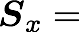
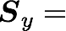
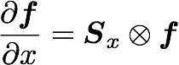
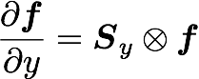
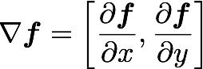
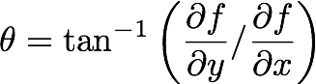
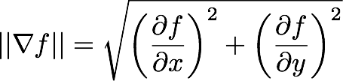
Computing image gradients
Select your favorite derivative filters.
1 | 0 | -1
2 | 0 | -2
1 | 0 | -1
1 | 2 | 1
0 | 0 | 0
-1 | -2 | -1
Convolve with the image to compute derivatives.
Form the image gradient, and compute its direction and amplitude.
gradient
direction
amplitude

Slide 23
Quiz 3. Image gradients
Quiz: Image gradients 구현
filter2D 를 사용하여 Image gradients 를 구현
cv.Sobel 사용 금지
오른쪽 그림과 같이 구현
Sobel filter
구현 결과 이미지를 미리 저장된 이미지와 테스트
Horizontal derivative, Vertical derivative
Amplitude
1 | 0 | -1
2 | 0 | -2
1 | 0 | -1
1 | 2 | 1
0 | 0 | 0
-1 | -2 | -1
amplitude

Slide 24
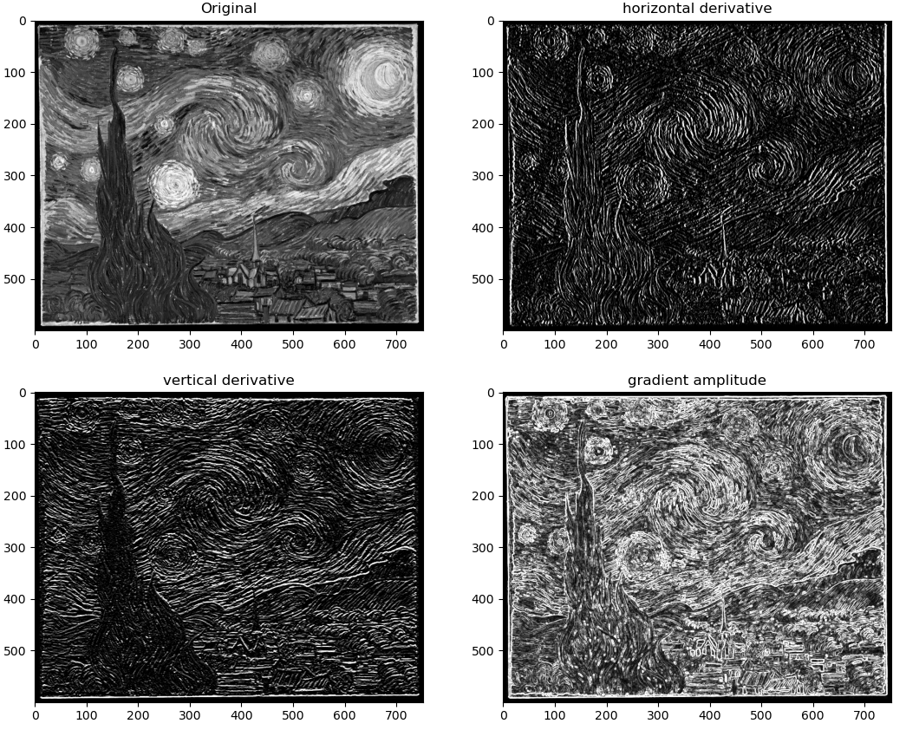
Image gradients examples

